Slide 1
An Efficient and Usable Client-Side Cross Platform Compatible Phishing Prevention Application
SECOND REVIEW
Guide
Dr. Angelin Gladston
Associate Professor
Department of CSE
Submitted by
N. Dhanush 2016103021
G. Santhosh 2016103057
S. Ben Stewart 2016103513

Slide 2
OUTLINE
INTRODUCTION
OVERALL OBJECTIVE
LITERATURE SURVEY
PROPOSED SYSTEM
HIGH LEVEL BLOCK DIAGRAM
MODULE LIST
IMPLEMENTATION
EVALUATION METRICS
REFERENCES

Slide 3
INTRODUCTION
Phishing
Lists of such sites
Time constraints
Computational resources
Vulnerabilities
Cross platform

Slide 4
OVERALL OBJECTIVE
Create a phishing list
Cross Platform application
Web browser add-on
Provide temporal resilience
Remove false positives from list

Slide 5
LITERATURE SURVEY
Previous work by Samuel Marchal, Giovanni Armano, Tommi Grondahl, Kalle Saari, Nidhi Singh, and N. Asokan
IEEE Trans. Comput., vol. 66, no. 10, pp. 1717-1733, Oct. 2017
Implemented a client-side phishing prevention application.
Had background tasks communicate with a browser add-on.
Not platform independent.

Slide 6
AUTOMATIC PHISHING CLASSIFICATION
Colin Whittaker, Brian Ryner and Marria Nazif for Google
Proc. Netw. Distrib. Syst. Security Symp., 2010
Features used
The URL of the page
The HTML page contents
The host server details
Needs blacklist updating.

Slide 7
CANTINA
Guang Xiang, Jason Hong, Carolyn P. Rose and Lorrie Cranor
ACM Trans. Inf. Syst. Secur., 2011
Page similarity
SHA 1 algorithm
Easy to break
Performance gains

Slide 8
AUTO UPDATED WHITELIST
Ankit Kumar Jain and B. B. Gupta
EURASIP J. Inf. Secur., vol. 2016, no. 1, Dec. 2016
Whitelist
the domain name
the IP address
Reverts to old system if not in whitelist

Slide 9
FUZZY ROUGH SET FEATURE SELECTION TO ENHANCE PHISHING ATTACK DETECTION
Mahdieh Zabihimayvan and Derek Doran
IEEE International Conference on Fuzzy Systems, June 2019
Fuzzy Rough Set (FRS) theory
Feature selection algorithm
Random Forest classification
No third party features

Slide 10
Paper | Journal/Conf. , Year | Contributions | Limitations
Large-Scale Automatic Classification of Phishing Pages | Proc. Netw. Distrib. Syst. Security Symp., 2010 | Machine learning model can be used with reliable accuracy. | Needs blacklist for updating.
CANTINA: A feature-rich machine learning framework for detecting phishing Web sites | ACM Trans. Inf. Syst. Secur., 2011 | SHA1 based similarity check for similar looking sites. | SHA1 could be manipulated.
A novel approach to protect against phishing attacks at client side using auto-updated white-list | EURASIP J. Inf. Secur., vol. 2016, no. 1, Dec. 2016 | Auto-updated whitelist for faster detection of sites on average. | Not temporally resilient.
Fuzzy Rough Set Feature Selection to Enhance Phishing Attack Detection | IEEE International Conference on Fuzzy Systems, June 2019 | Feature selection. | Not a user oriented application.

Slide 11
PROPOSED SYSTEM
Platform independent
Browser add-on
Reduce false warnings
Context independent detection
Static observations

Slide 12
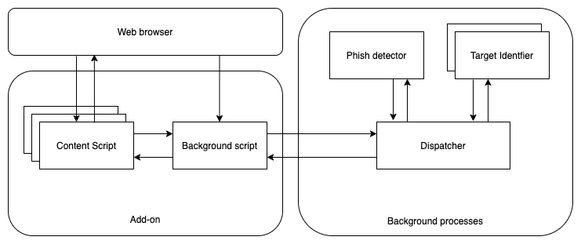
SYSTEM ARCHITECTURE

Slide 13
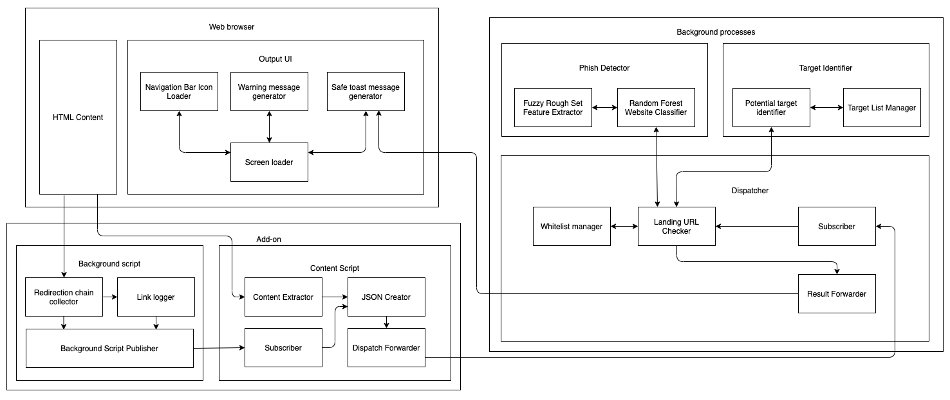
HIGH LEVEL BLOCK DIAGRAM

Slide 14
MODULE LIST
Add on
Background script
Content script
Background process
Dispatcher
Phish Detector
Target Identifier
Web Browser
HTML content
Output UI

Slide 15
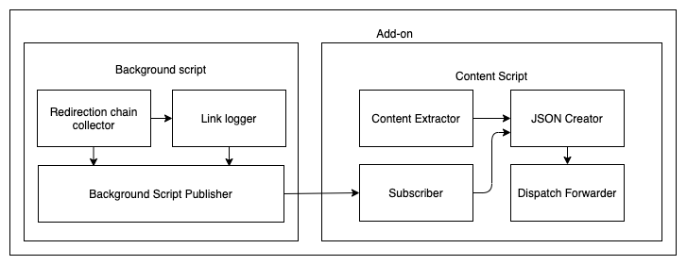
ADD-ON

Slide 16
BACKGROUND SCRIPT
Begin
For each page load redirect
Add listener to that event
Get the list of redirects from listener
If page is fully loaded
Send the list of redirects to content script
Done
End

Slide 17
CONTENT SCRIPT
Begin
For each page load redirect
If page is fully loaded
Get the URL from the tab
Get the HTML content from innerHTML tag
Get redirection list from background script
Send them to the background process
Done
End

Slide 18
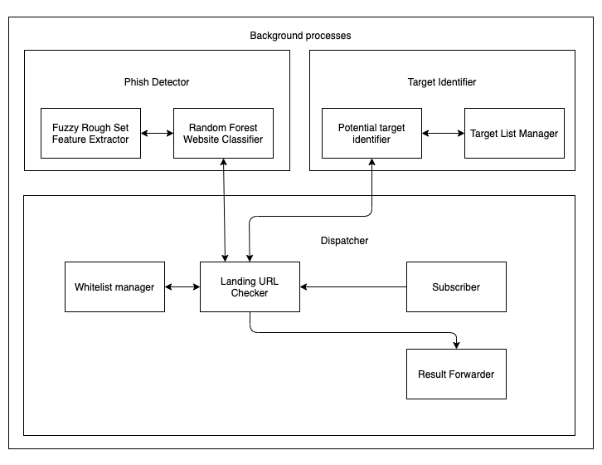
BACKGROUND PROCESS

Slide 19
DISPATCHER
Begin
If page address is in whitelist
Send the GREEN signal
Else
Send content to phish detector
Get results from phish detector
If phish is FALSE
Send the GREEN signal
Else
Send the RED signal
Send content to target identifier
If target is found
Publish target
Else
No target matched
End

Slide 20
PHISH DETECTOR
Begin
For each page URL
Get the fuzzy set feature values for the URL
Load the saved random forest model
Publish the result
Done
End

Slide 21
FUZZY ROUGH SET
Begin
Compute indiscernibility matrix M(A)
Reduce M using absorption laws
d - number of non-empty fields
Initialise all fields
For all fields
Compute fields using formulas R=SUT
Done
End

Slide 22
RANDOM FOREST MODEL
Begin
For each record in dataset
Get the fuzzy set feature values
Create an arff file to save results
Done
Train the dataset with at least 7 splits as random forest
Save the model as pkl file
End

Slide 23
TARGET IDENTIFIER
Begin
Remove all href tags in page
Get the hash value for page content
Compare with values in hash list
If match
Display target
Else
No target found
End

Slide 24
SHA
Begin
Input is an array 8 items long where each item is 32 bits.
Calculate all the function boxes and store those values.
Store input, right shifted by 32 bits, into output.
Store the function boxes.
Store (Input H + Ch + ( (Wt+Kt) AND 2^31 ) ) AND 2^31 As mod1
Store (sum1 + mod1) AND 2^31 as mod2
Store (d + mod2) AND 2^31 into output E
Store (MA + mod2) AND 2^31 as mod3
Store (sum0 + mod3) AND 2^31 into output A
Output is an array 8 items long where each item is 32 bits.
End

Slide 25
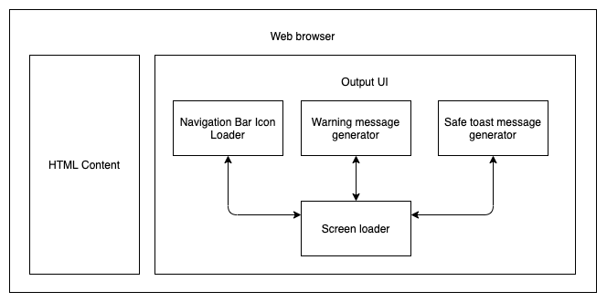
WEB BROWSER

Slide 26
OUTPUT UI
Begin
If site is phish
Change icon to red
Display warning message
If site has target
Display target link
Else
Display no target
Else
Change icon to green
Display safe to proceed message
End

Slide 27
IMPLEMENTATION
Add on
Background script
Content script
Background process
Dispatcher
Phish Detector
Target Identifier
Web Browser
HTML content
Output UI

Slide 28
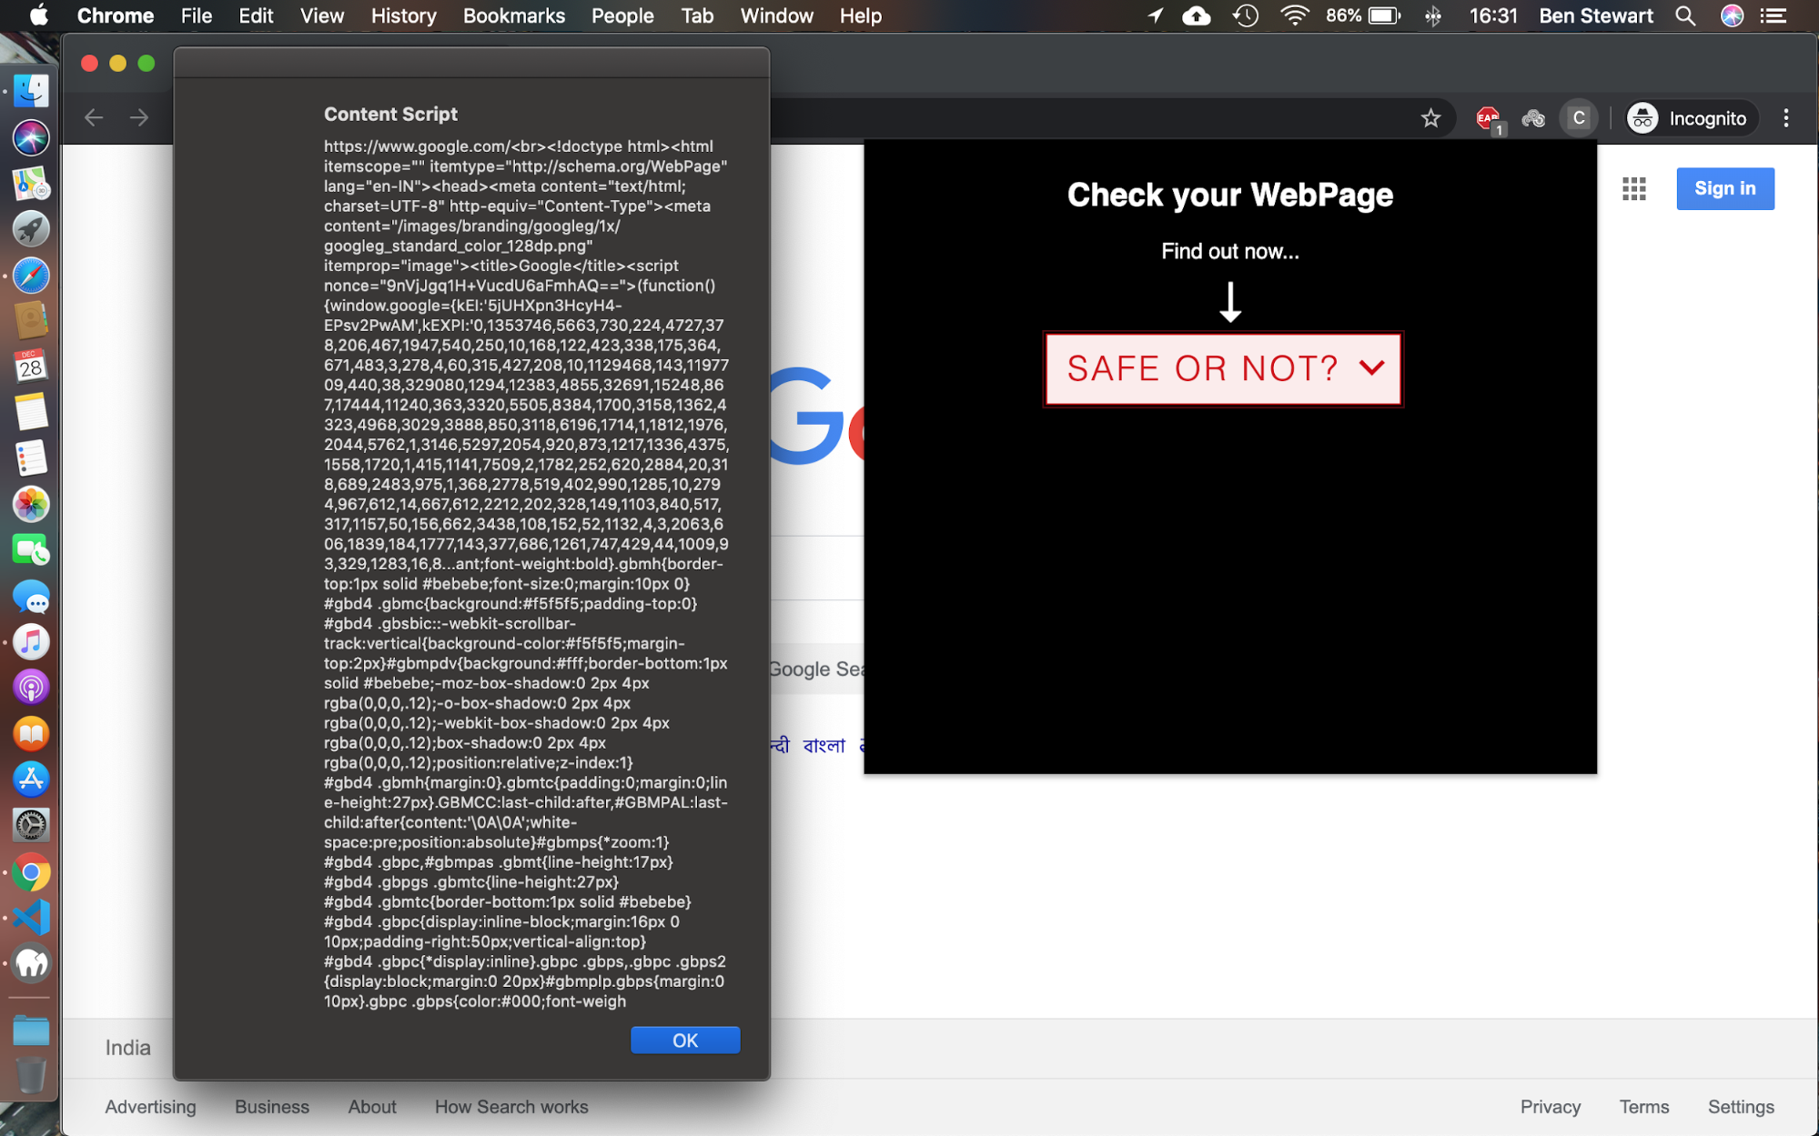
CONTENT SCRIPT

Slide 29
CONTENT SCRIPT
//Retrieve URL JS
tablink = tab.url;
//Retrieve Page content PHP
$site=$_POST['url'];
$html = file_get_contents($site);

Slide 30

BACKGROUND SCRIPT

Slide 31
BACKGROUND SCRIPT
//URL path item
url: pathItem.url,
status: pathItem.status_line,
redirect_type: pathItem.redirect_type,
redirect_url: pathItem.redirect_url,
meta_timer: pathItem.meta_timer

Slide 32
DATASET
30 features
23827 records
Scraped from PhishTank
Up-to-date

Slide 33
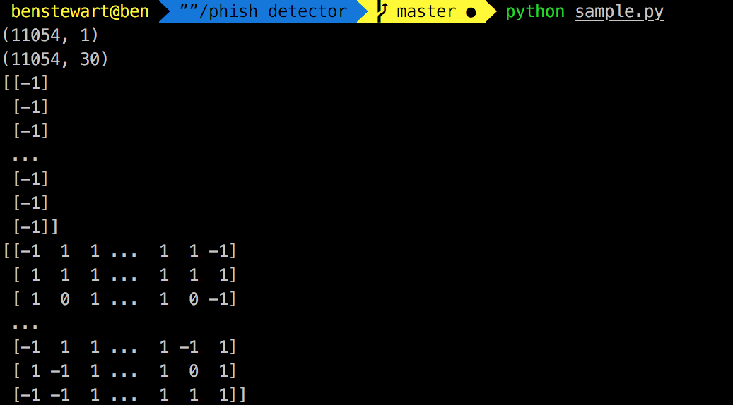
FEATURE SELECTION

Slide 34
FEATURE SELECTION
selector = RoughSetsSelector()
X_selected = selector.fit(X, y).transform(X)

Slide 35
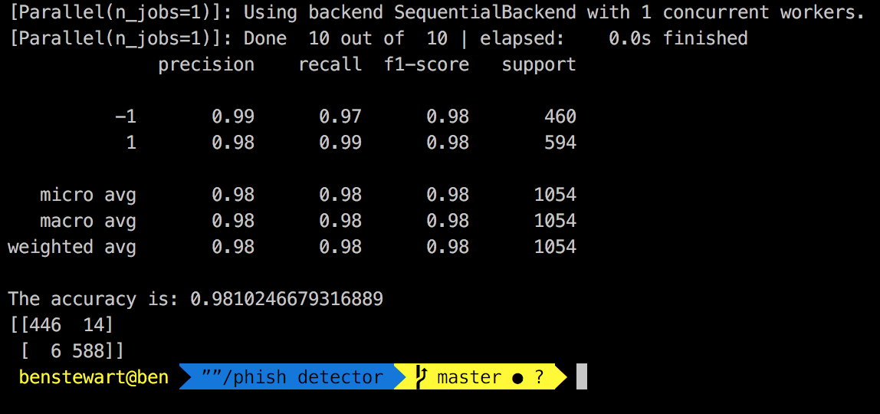
RANDOM FOREST MODEL
WITHOUT FEATURE SELECTION

Slide 36
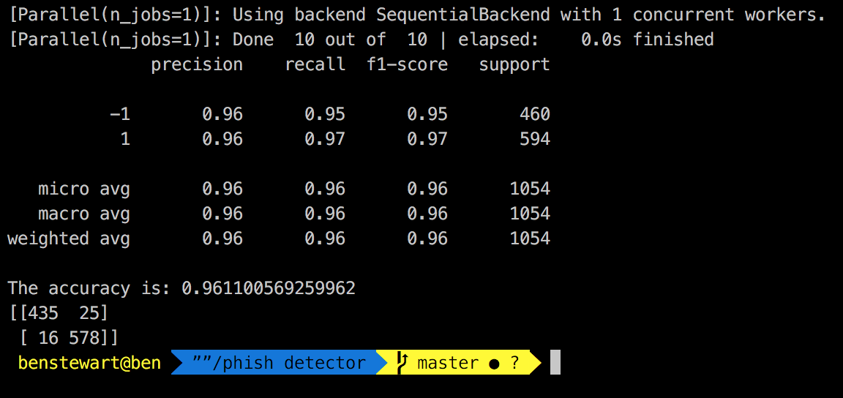
RANDOM FOREST MODEL
WITH FEATURE SELECTION

Slide 37
RANDOM FOREST MODEL
//create model
clf4=RandomForestClassifier(min_samples_split=7)
clf4.fit(features_train, labels_train)
//save the model
joblib.dump(clf4, 'classifier/random_forest.pkl', compress=9)
//feature weightage
importances = clf4.feature_importances_
//confusion matrix
print metrics.confusion_matrix(labels_test, pred4)

Slide 38

TARGET IDENTIFIER
tags1 = get_tags(lxml.html.parse(path1))
tags2 = get_tags(lxml.html.parse(path2))
diff = difflib.SequenceMatcher()
diff.set_seq1(tags1)
diff.set_seq2(tags2)
params['url'] = url
response=requests.get(url, headers=headers, params=params)

Slide 39
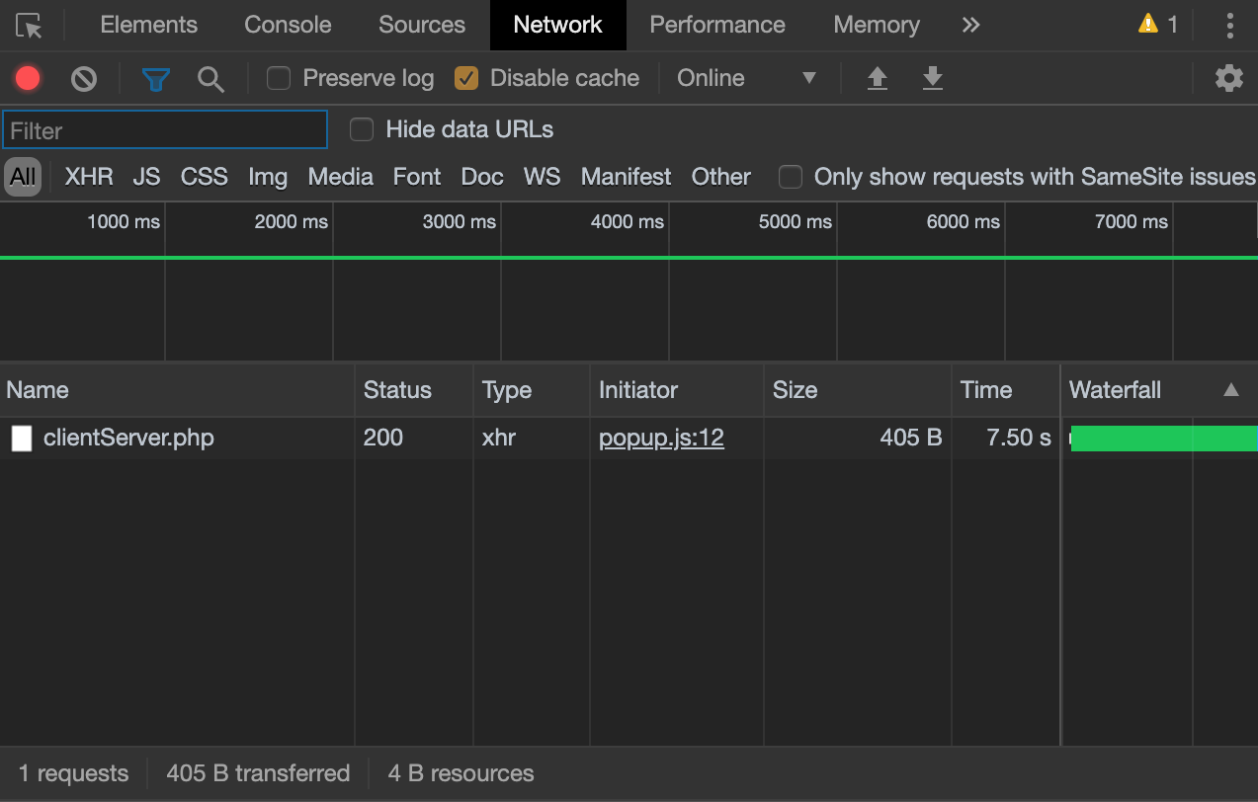
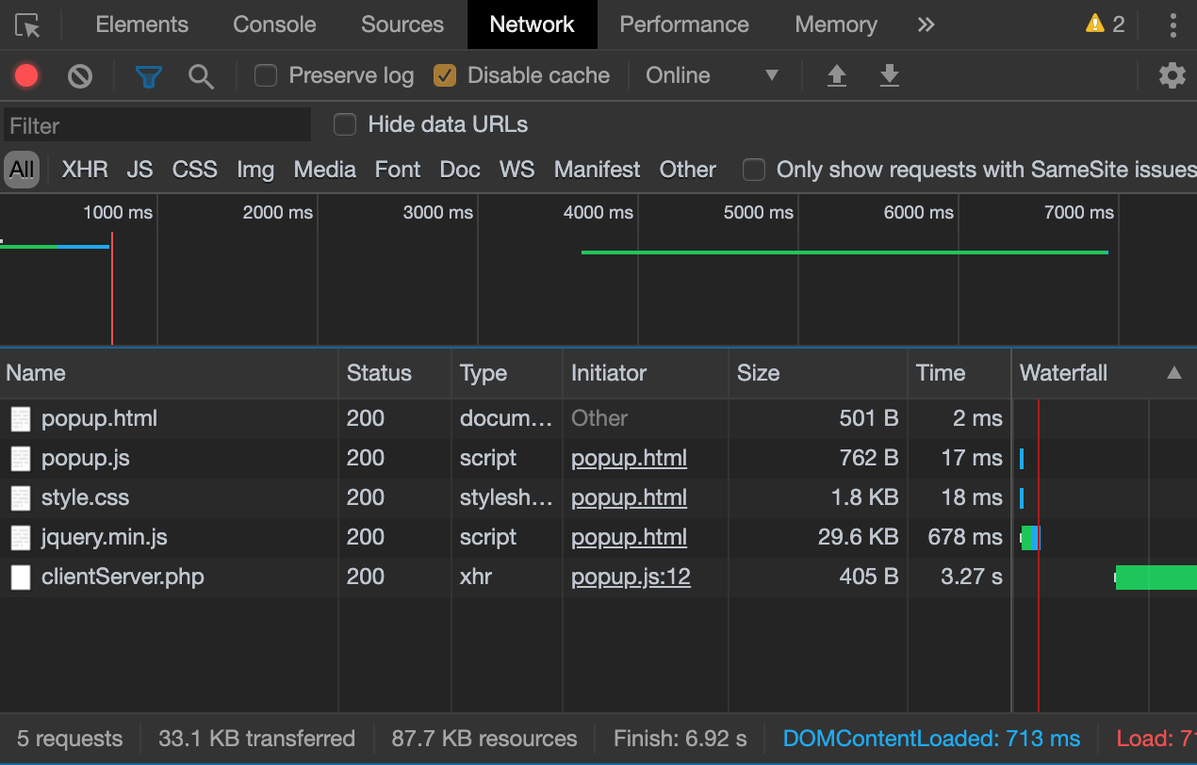
AUTO UPDATED WHITELIST

Slide 40
AUTO UPDATED WHITELIST
//insert into whitelist
white_list_file=open('whitelist.txt', "a+")
white_list_file.write(url)
//search whitelist
white_list_file = open('whitelist.txt').read()
white_list = white_list_file.split('\n')
if url in white_list:
#url is safe

Slide 41
DISPATCHER
$decision=exec("python test.py $site 2>&1 ");
echo $decision;
//temporal resilience
$decision=exec("python scrape.py single-sites.json 1 data");

Slide 42
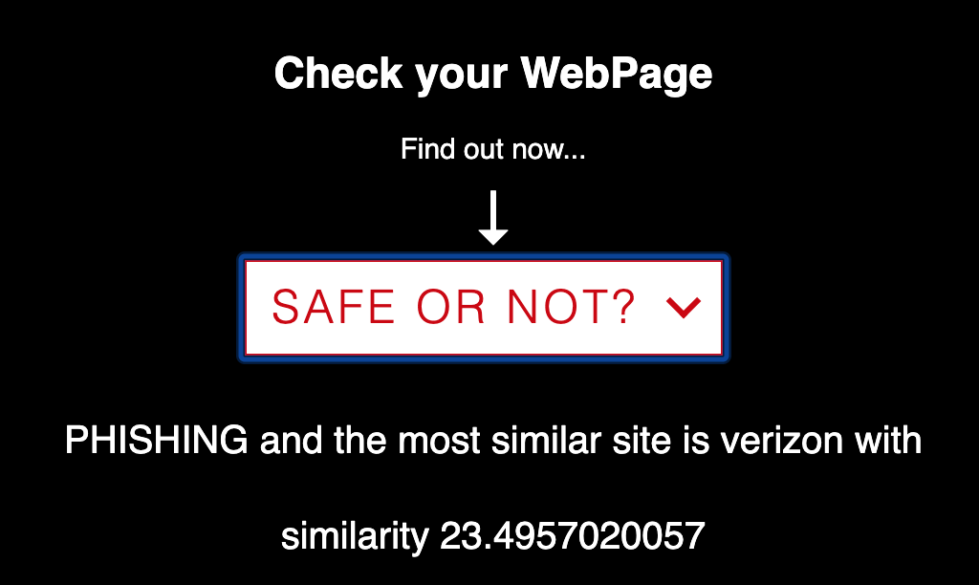
OUTPUT UI

Slide 43
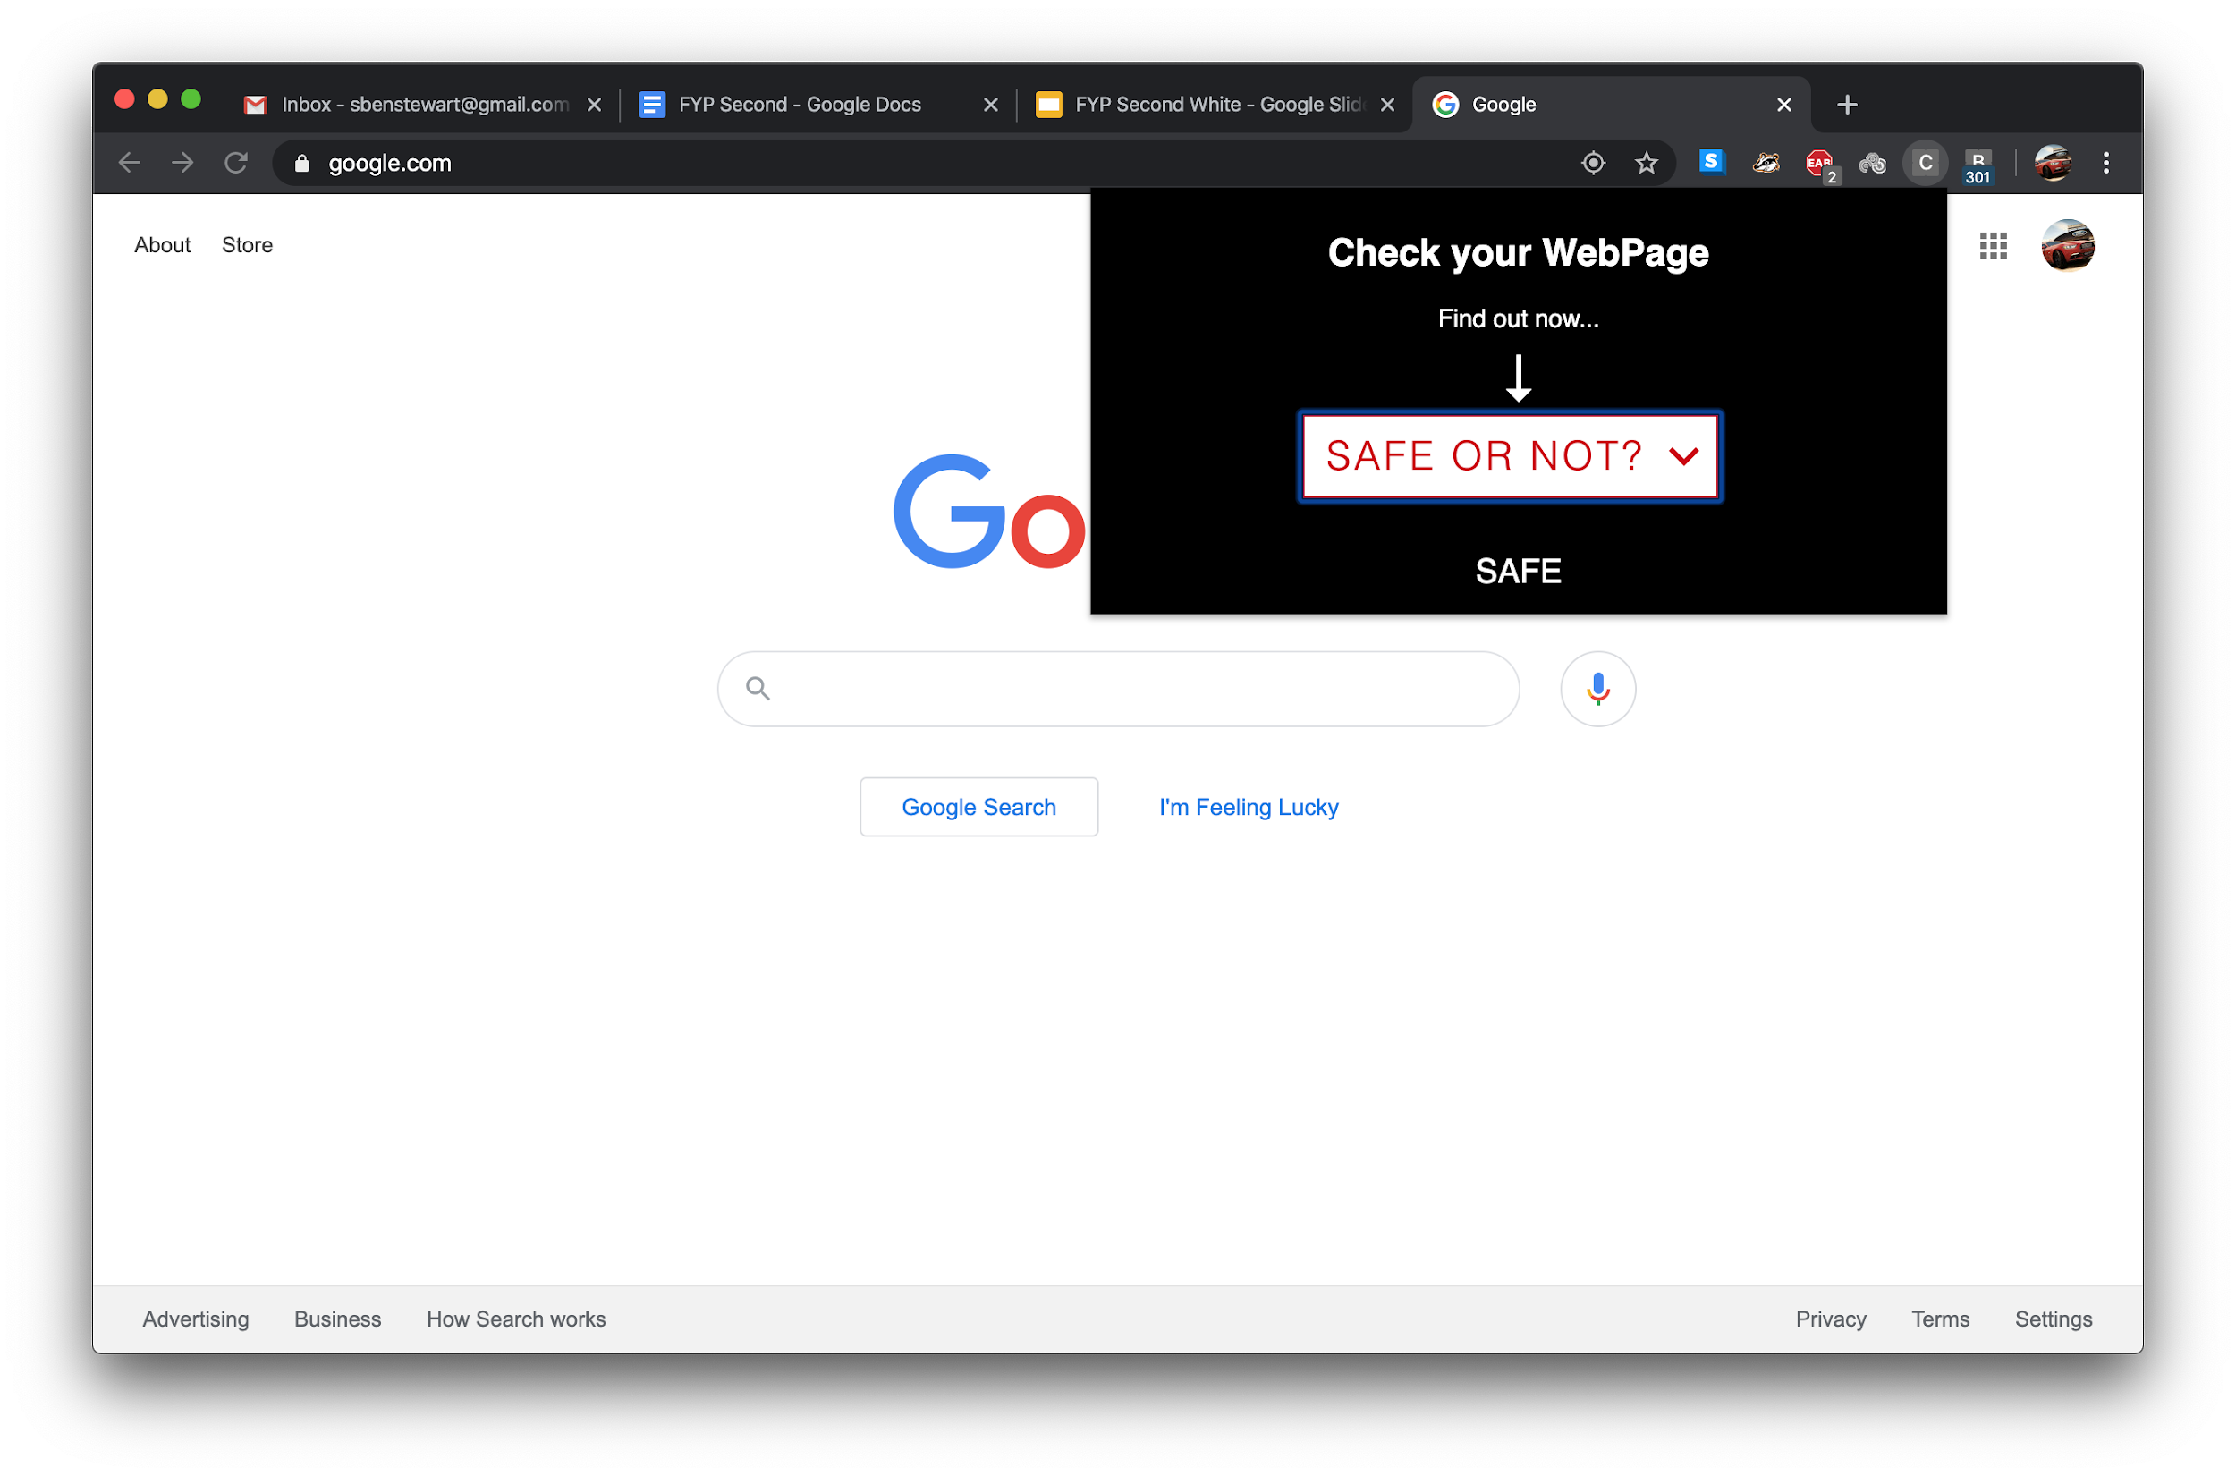
SAFE HTML CONTENT

Slide 44
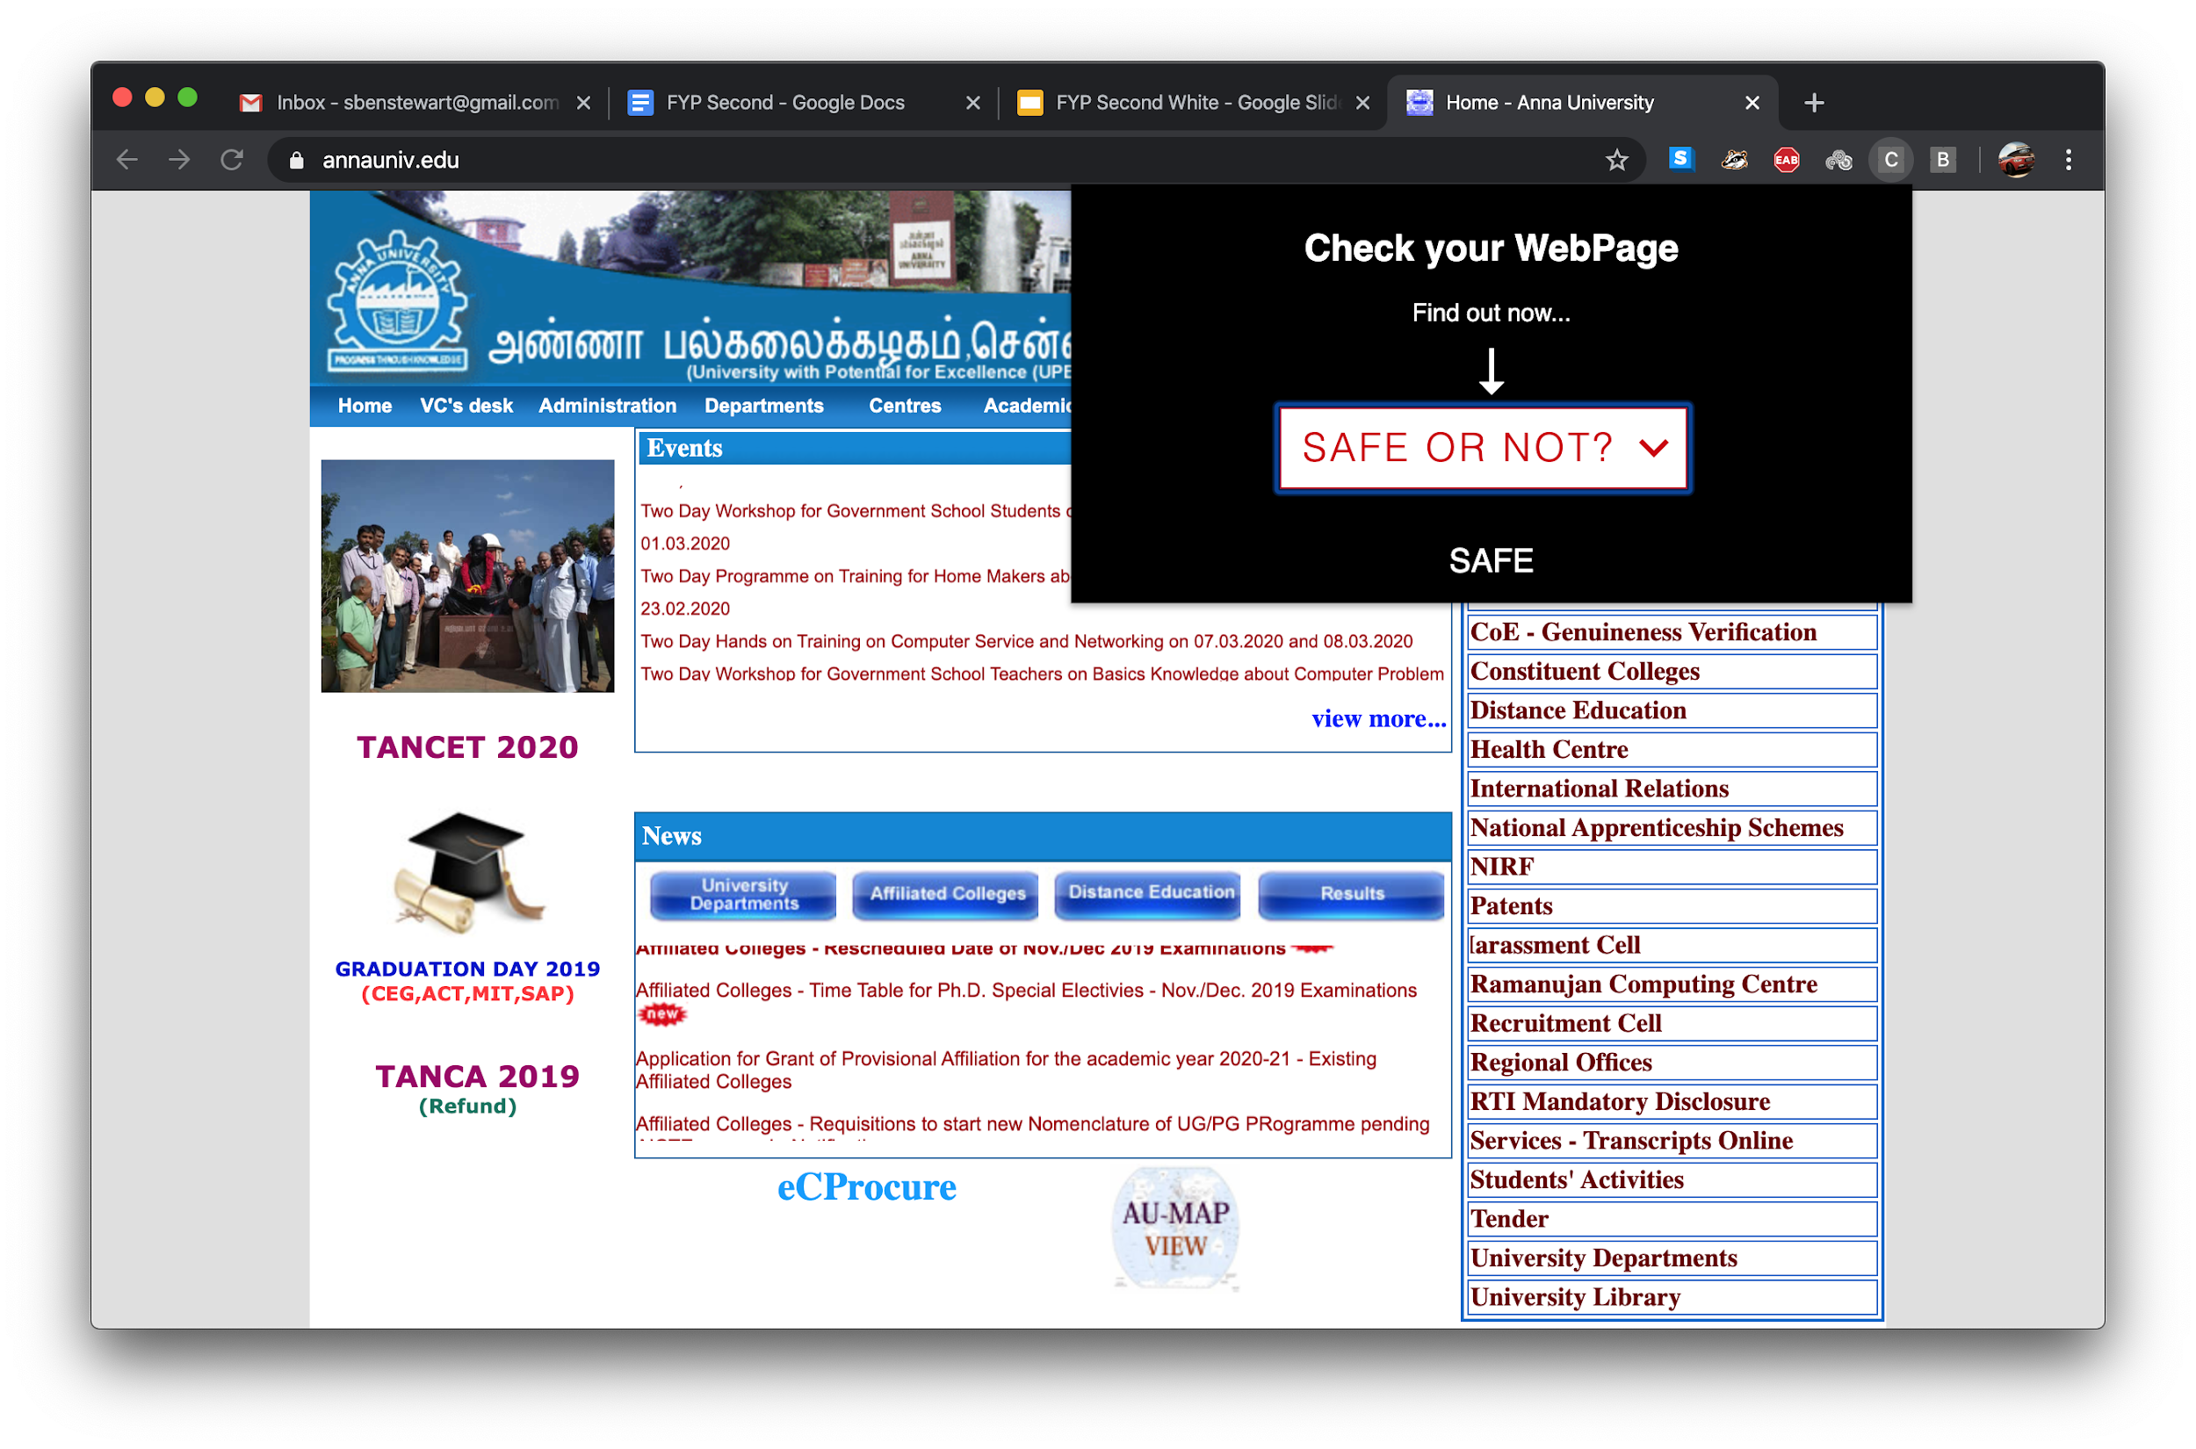
SAFE HTML CONTENT

Slide 45
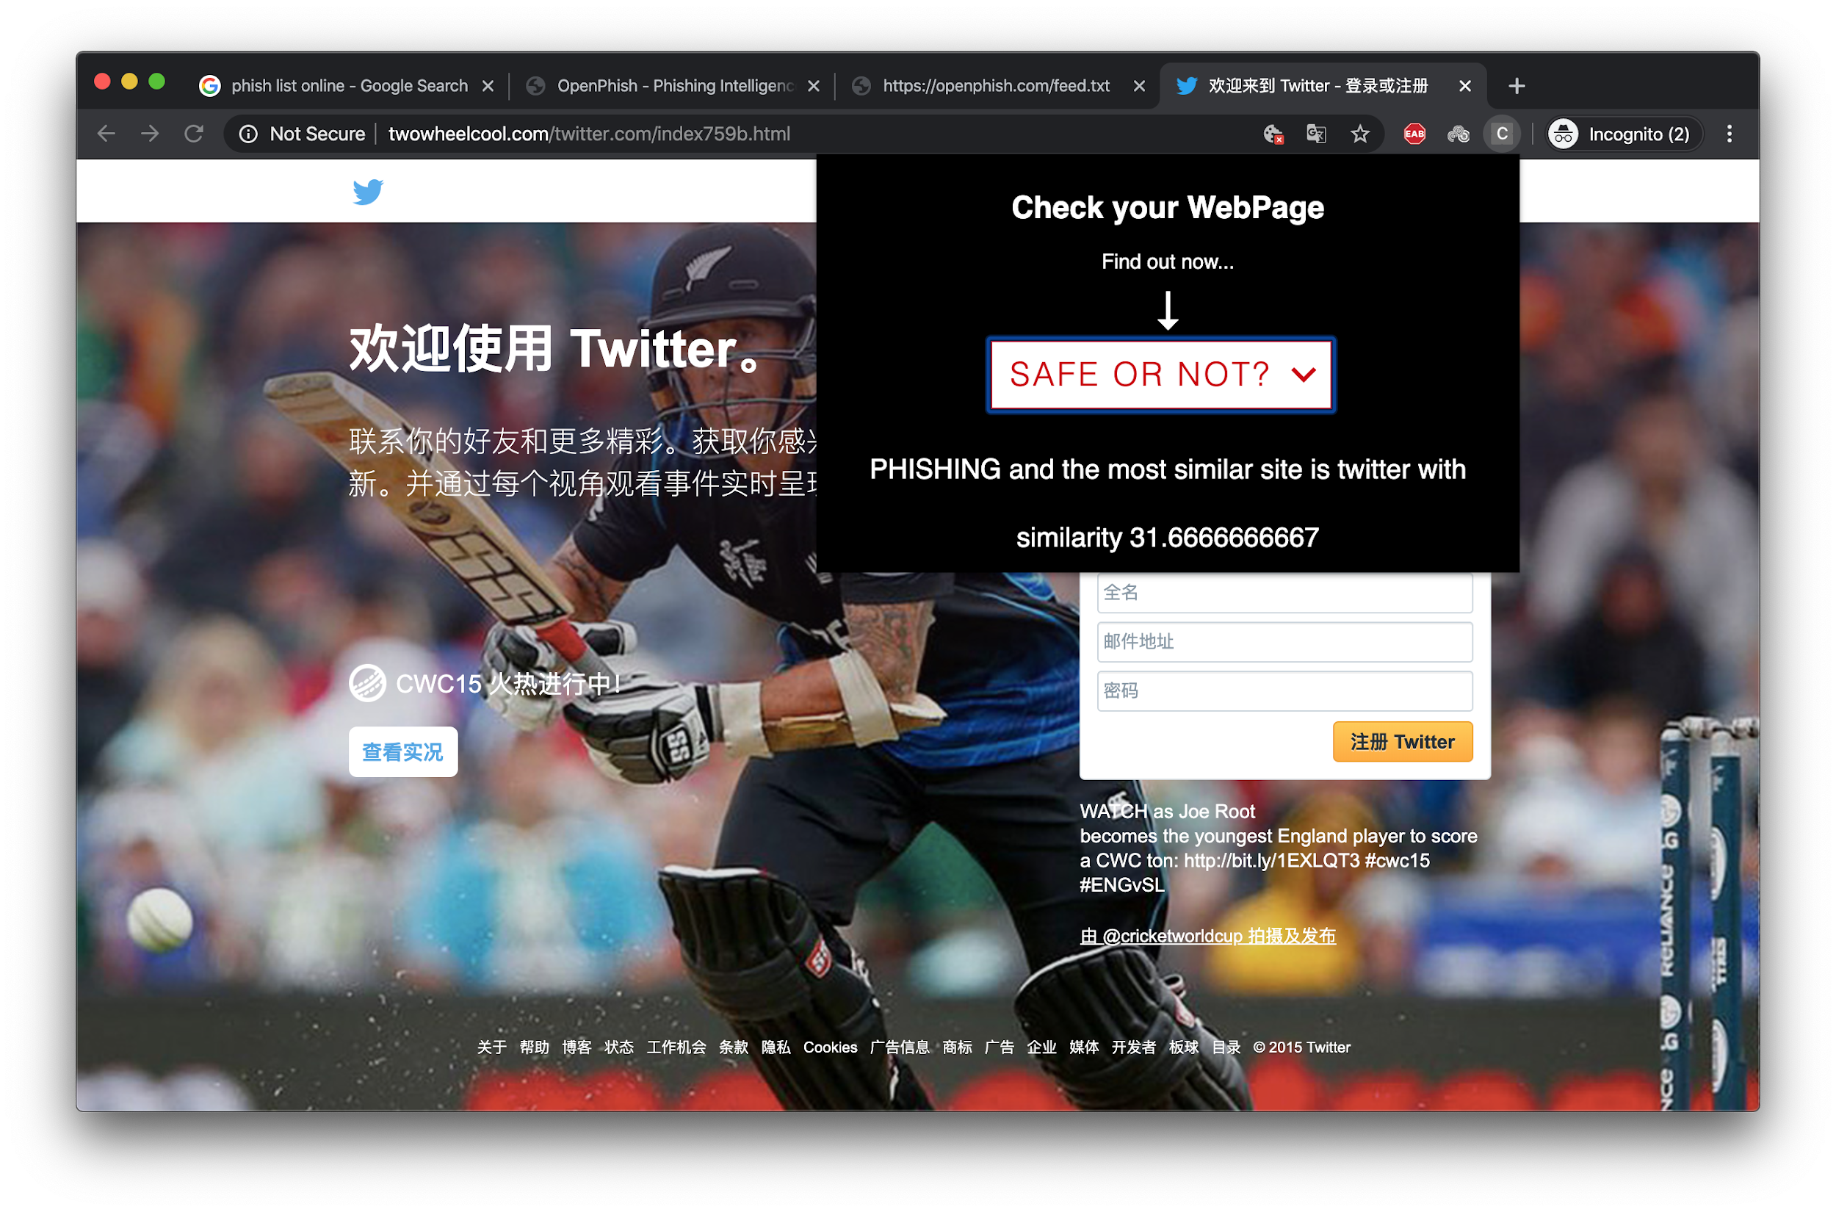
PHISHING HTML CONTENT

Slide 46
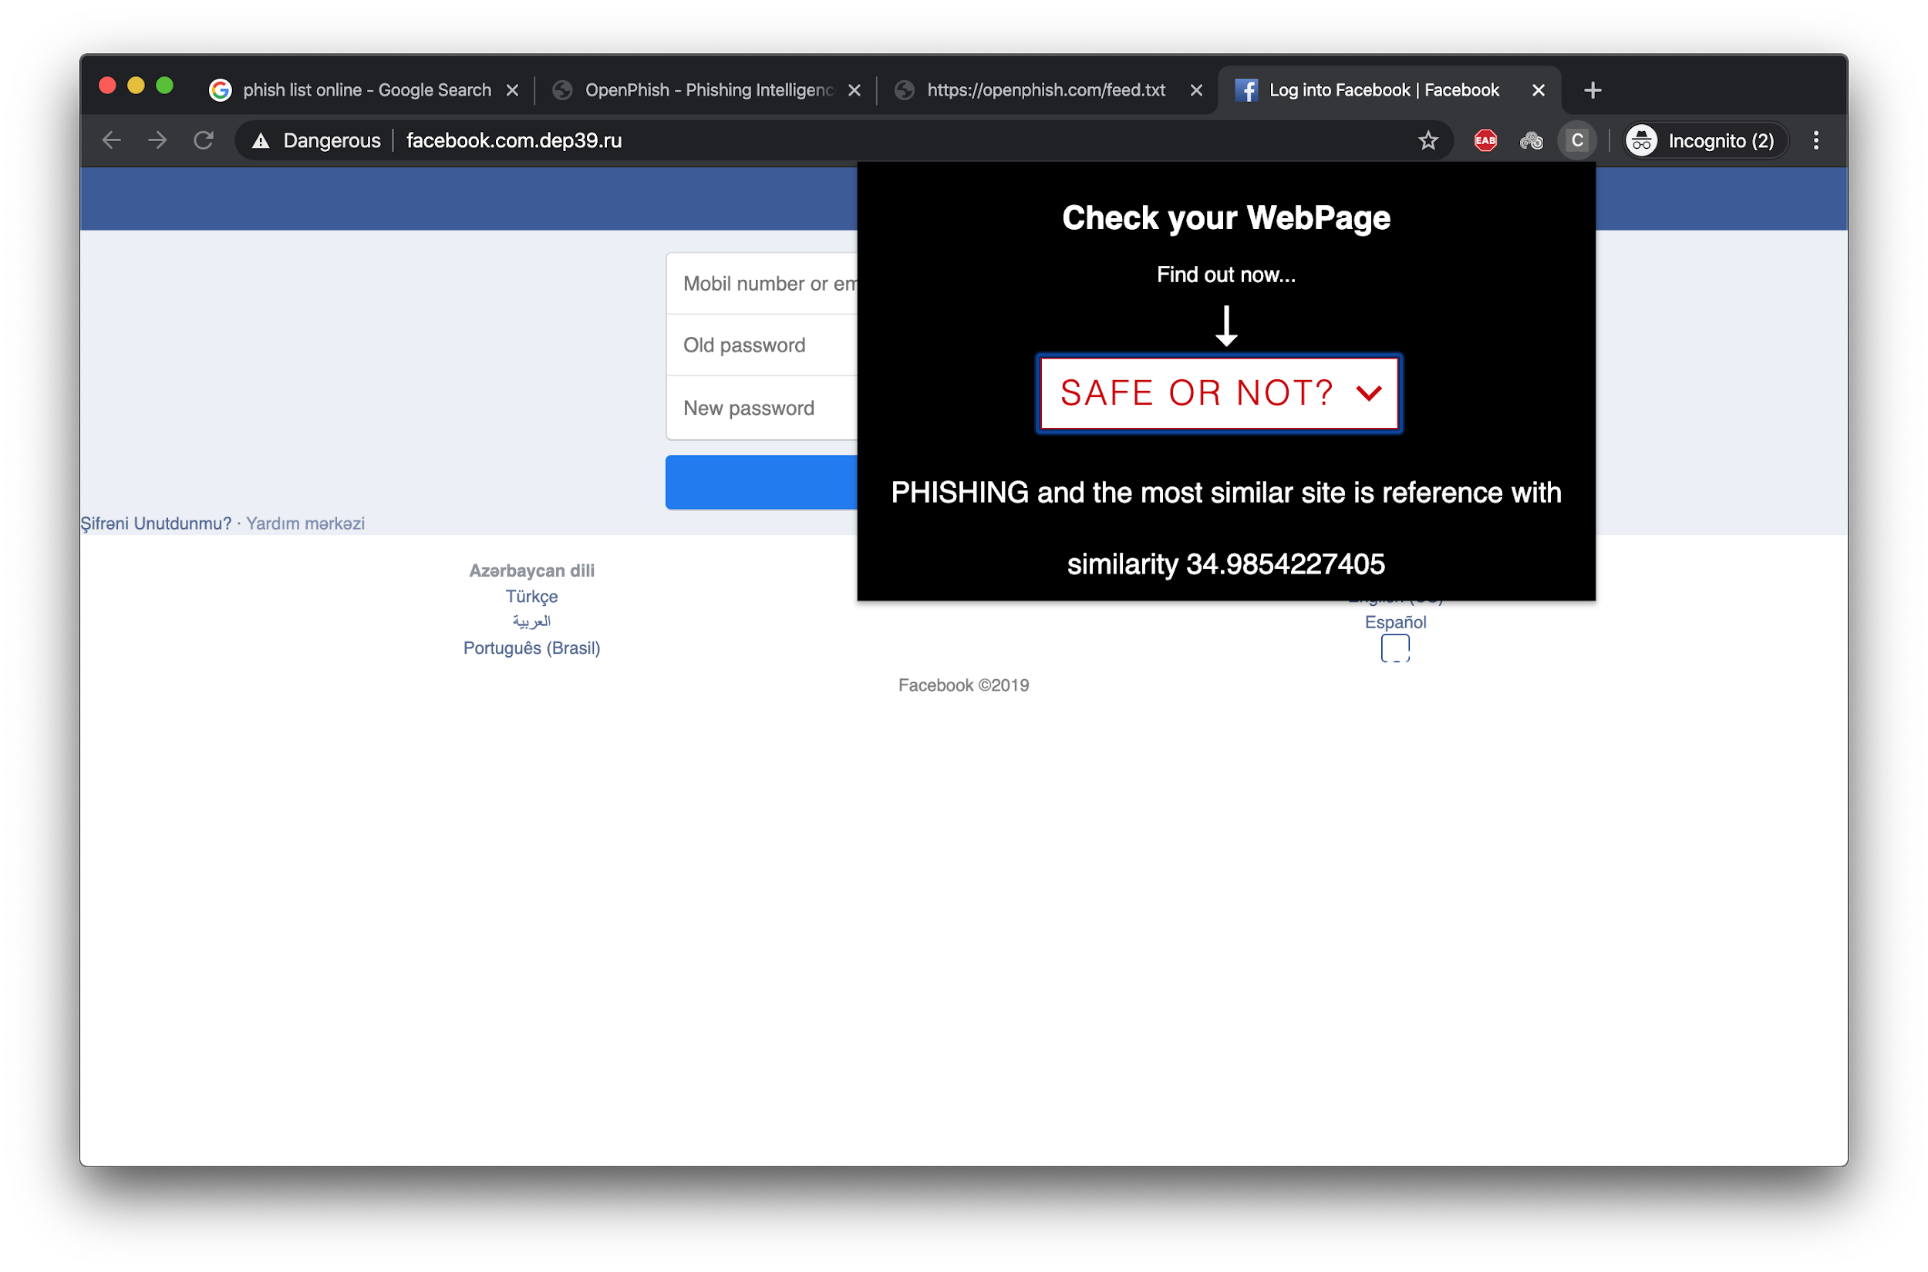
PHISHING HTML CONTENT

Slide 47
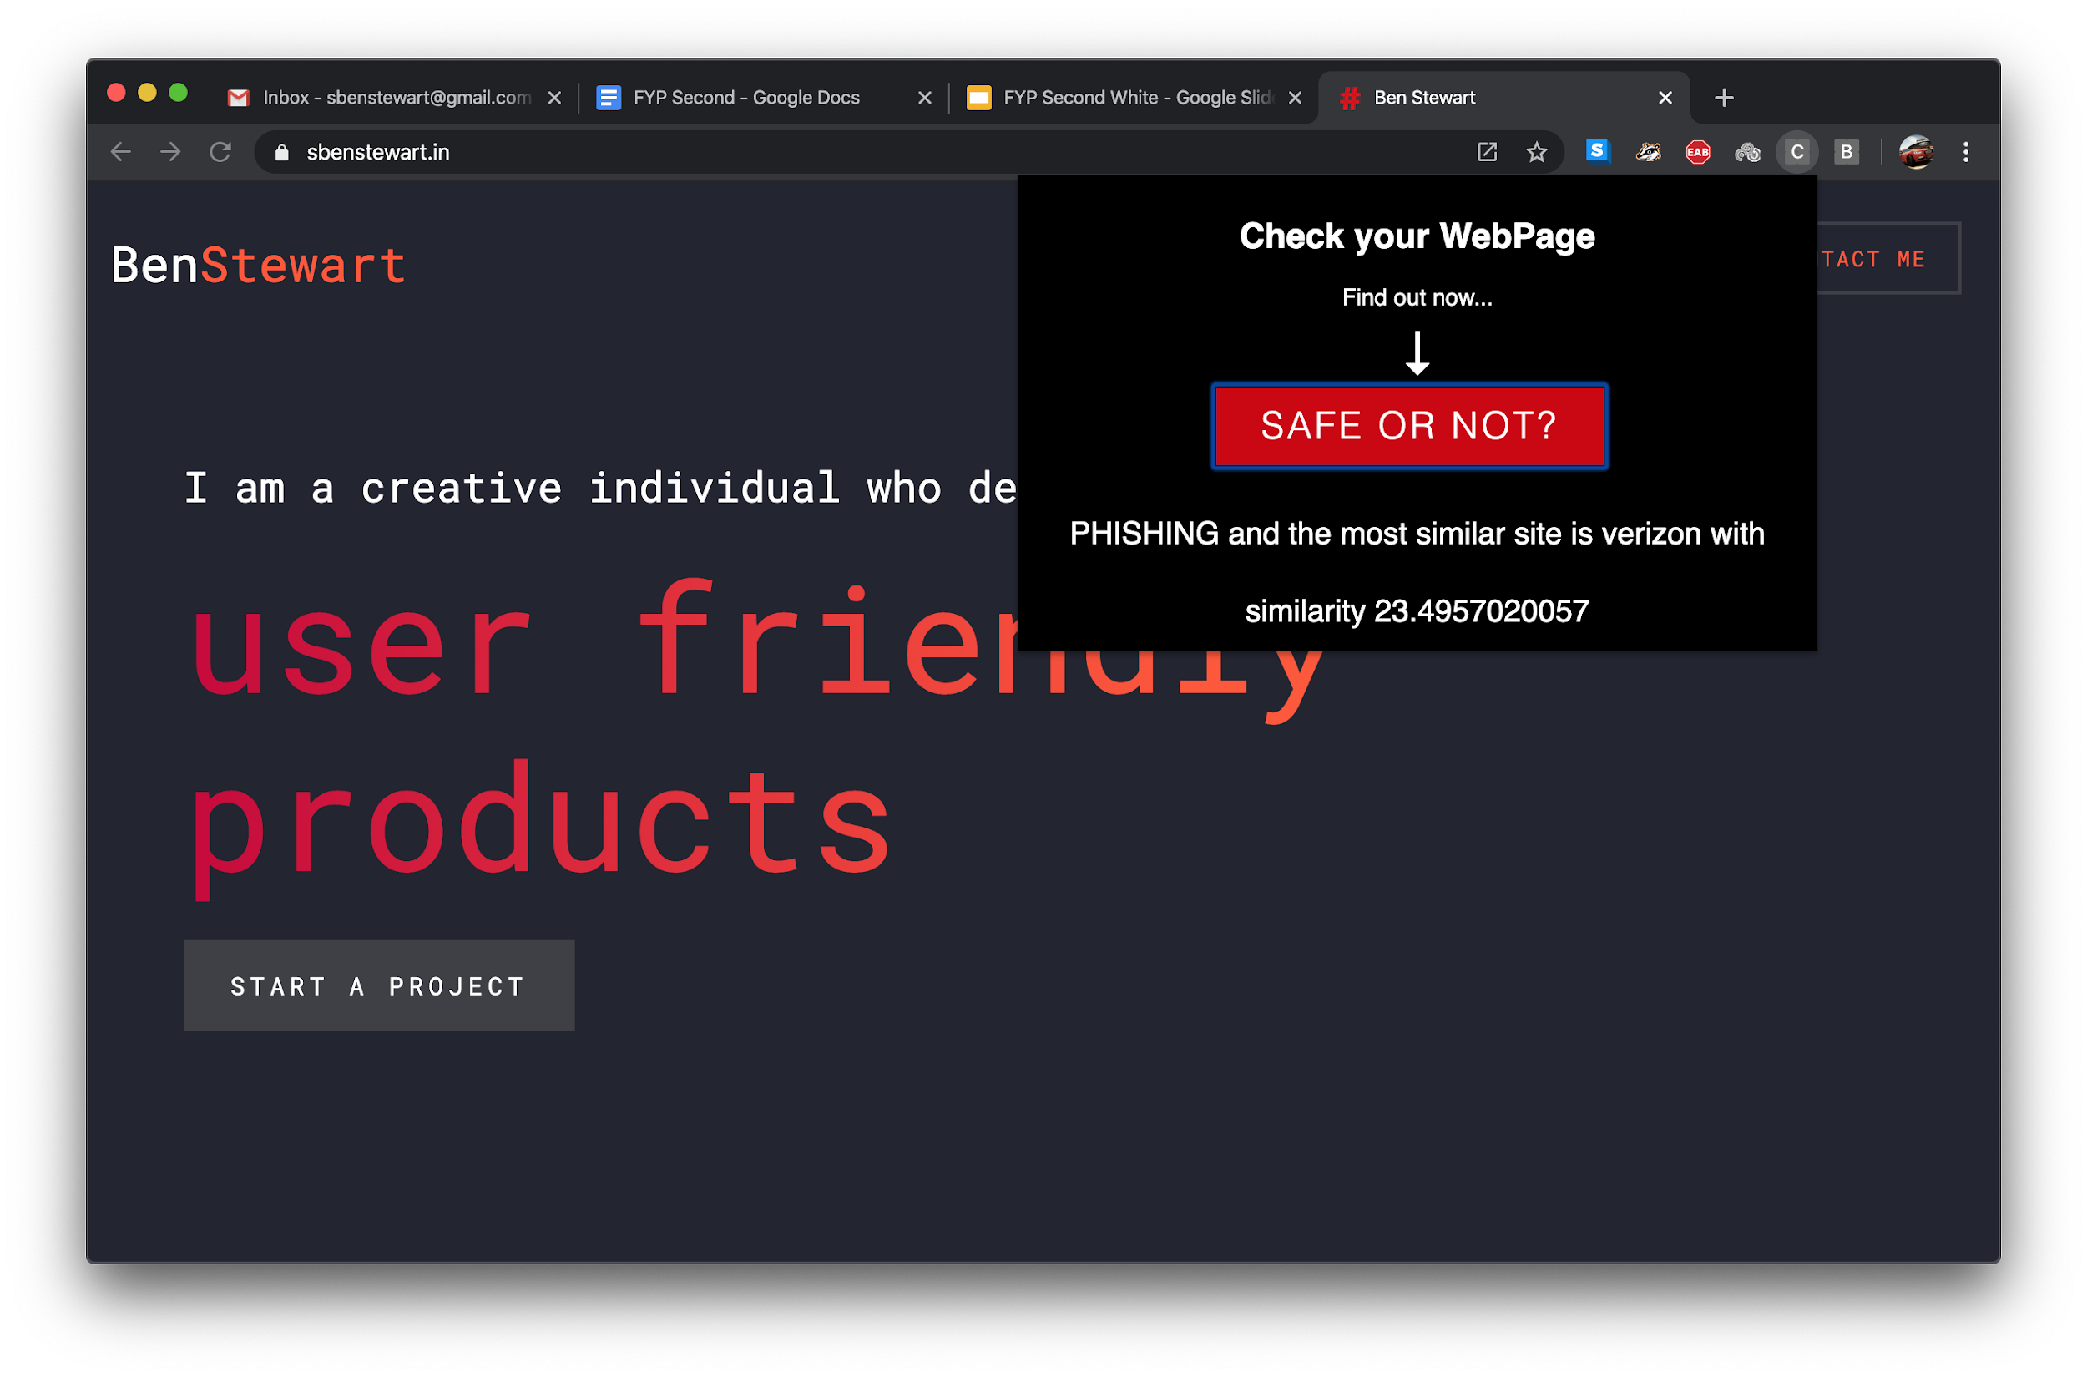
WRONG HTML CONTENT

Slide 48
EVALUATION METRICS
Phish detection accuracy
Accuracy = (TP+TN)/(TP+TN+FP+FN)
Target detection ratio
Detection Ratio = (TP)/(TP+TN+FP+FN)
Memory usage profiling
Current total memory usage = Total Memory - (Free + Buffers + Cached)
Addon rendering time
Rendering Time = End time - Start time
Temporal resilience accuracy
Accuracy = (TP+TN)/(TP+TN+FP+FN)

Slide 49
REFERENCES
Mahdieh Zabihimayvan and Derek Doran, "Fuzzy Rough Set Feature Selection to Enhance Phishing Attack Detection", IEEE International Conference on Fuzzy Systems, June 2019.
S. Marchal, G. Armano, T. Gröndahl, K. Saari, N. Singh, N. Asokan, "Off-the-hook: An efficient and usable client-side phishing prevention application", IEEE Trans. Comput., vol. 66, no. 10, pp. 1717-1733, Oct. 2017.
A. K. Jain, B. B. Gupta, "A novel approach to protect against phishing attacks at client side using auto-updated white-list", EURASIP J. Inf. Secur., vol. 2016, no. 1, Dec. 2016.
G. Xiang, J. Hong, C. P. Rosé, L. Cranor, "CANTINA: A feature-rich machine learning framework for detecting phishing Web sites", ACM Trans. Inf. Syst. Secur., vol. 14, no. 2, 2011.
Implementation for the Usage of Google Safe Browsing APIs (v4), 2019, [online] Available: https://github.com/google/safebrowsing.
C. Whittaker, B. Ryner, and M. Nazif, “Large-scale automatic classification of phishing pages,” in Proc. Netw. Distrib. Syst. Security Symp., 2010, pp. 1–14.

